Slide 1


Festival of Architecture
Toronto
October 27-31, 2019
Danske Arkitektvirksomheder
Royal Consulate General, Toronto, Canada

Slide 2

Why Toronto, Canada?
Canada has a taste for Danish design
Projects in Toronto, Vancouver, Halifax by Danish architects
Attention of Canada’s biggest developers
Opportunity to visit Danish projects in Toronto, Canada
Opportunity to learn about practicing architecture in Canada
Opportunity to meet Canadian architects of all sizes (small, medium, large firms) to discuss joint-ventue partnerships
Opportunity to meet Canadian architects from different cities in Canada at one conference
Joint venture partnership collaboration
Bjarke Ingels Group

Slide 3
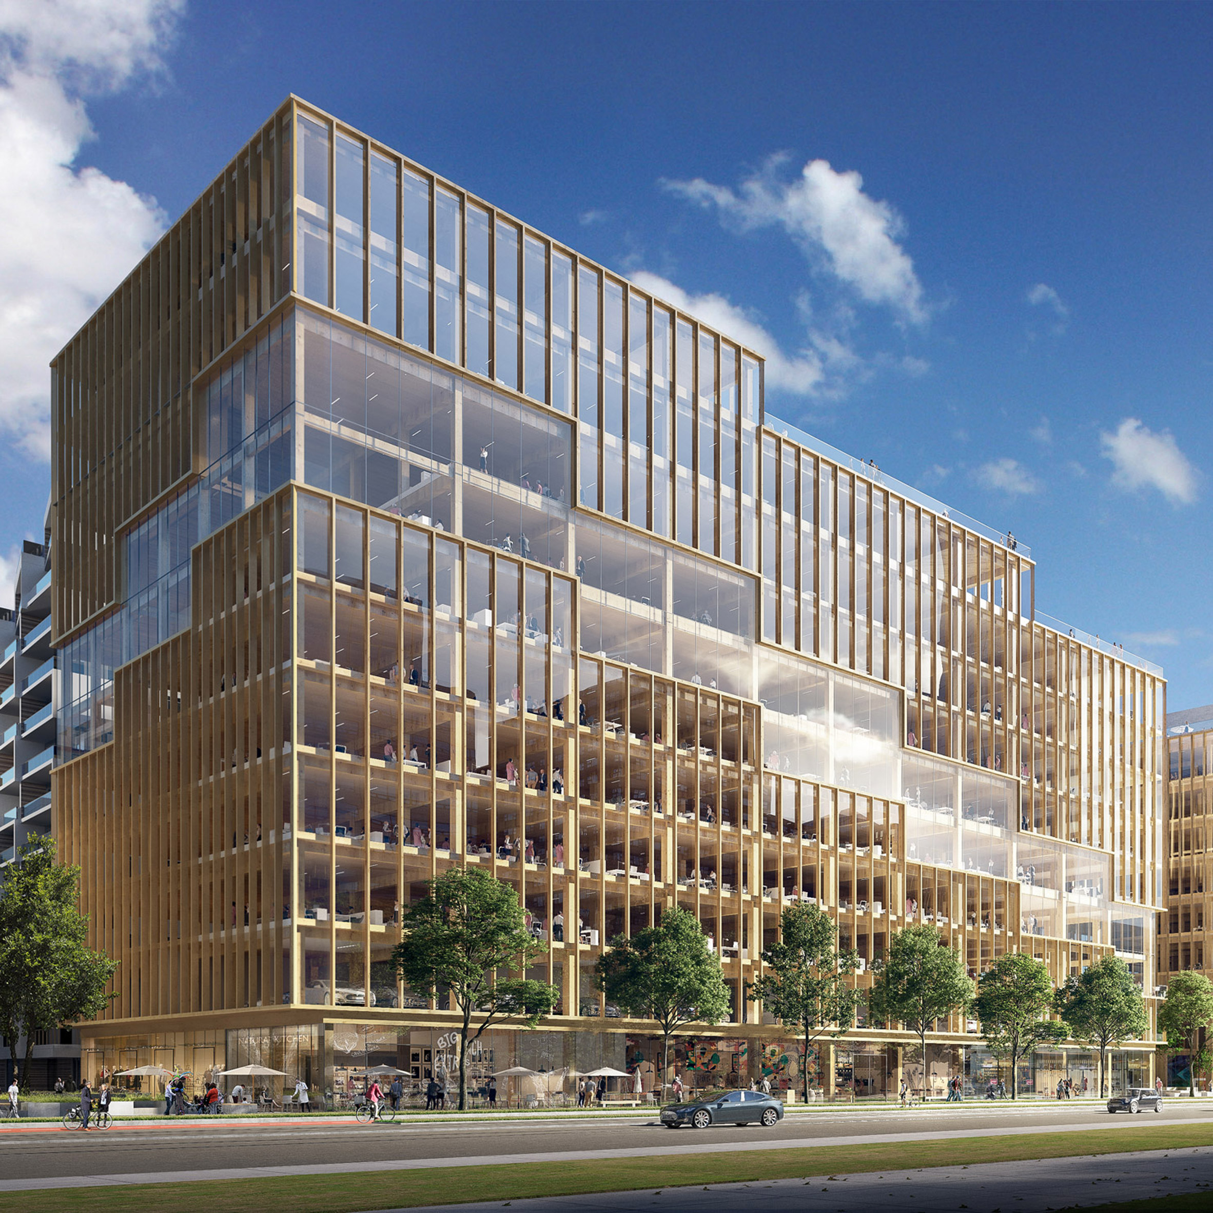
Program for Danish architecture delegation to RAIC Festival of architecture in Toronto
Sunday, October 27, 2019 - Arrival
Depart Denmark
Arrival in Toronto (approximately 16:00 EST)
Welcome dinner at stylish Toronto resturant
Monday, October 28, 2019
Introduction to Toronto:
Walking tour of Toronto architecture by Pamela Tiller
Introduction to the Greater Toronto Area by Global Toronto (inbound business investment agency)
Potential site tour of Danish architectural project in Toronto (i.e. 3XN Aqualuna at Bayside).
Evening: RAIC Festival President’s Reception, Dinner and Awards Gala
The celebratory highlight of the conference! This must-attend event, starting at 6:00 p.m., honours and recognizes those individuals and teams whose dedication to architecture has led to exceptional achievements in design excellence, sustainability, innovation, and more. Come, enjoy, and be inspired!
T3 Wood Building – 3XN

Slide 4
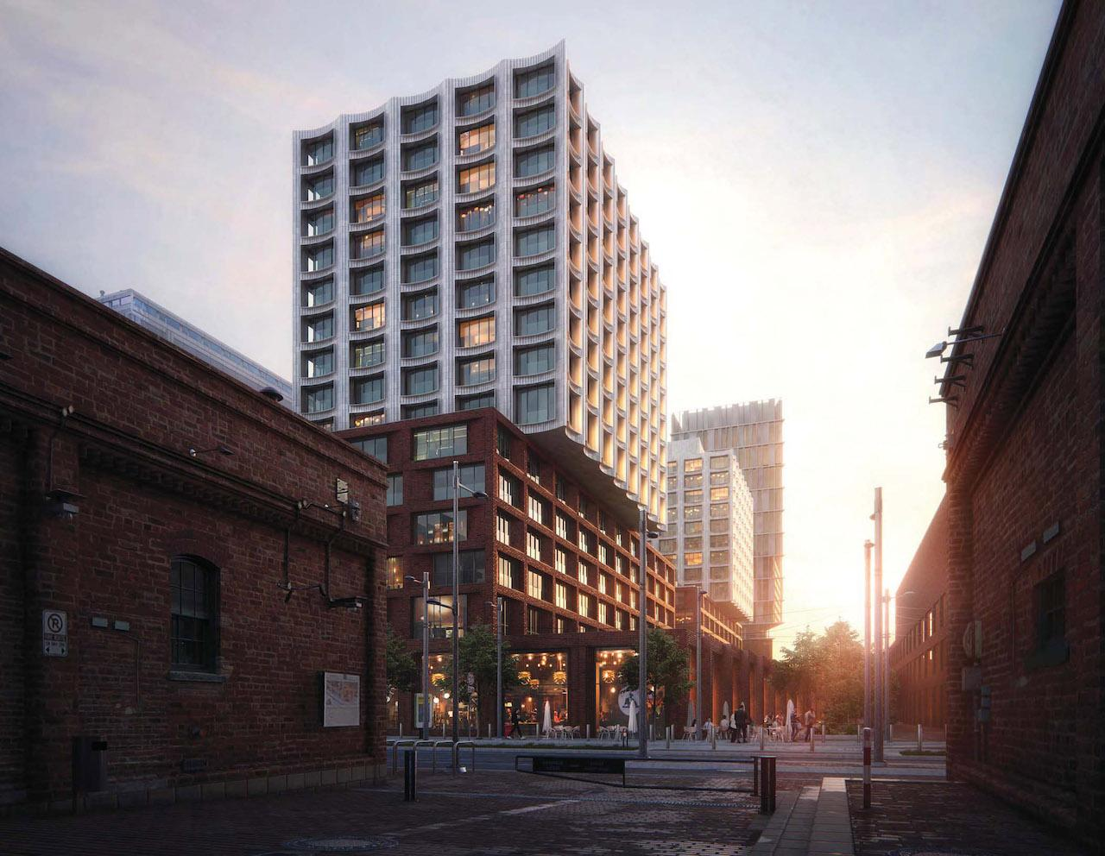
Program for Danish architecture delegation to RAIC Festival of architecture in Toronto
Tuesday, October 28, 2019 – Attend Conference Festival
Delegation attends conference sessions for RAIC Festival of Architecture
Currated Business-to-Business Match-Making Event for Danish architects to meet Canadian architects from key city markets across Canada such as: Halifax, Quebec City, Montreal, Ottawa, Kington, Toronto, Hamilton, Kitchener-Waterloo, London, Windsor, Winnipeg, Saskatoon, Regina, Edmonton, Calgary, Kelowna, Vancouver, Victoria
Evening Event: RAIC College of Fellows and Syllabus Program Convocation
The RAIC College of Fellows Convocation and Syllabus Convocation will be held at the Royal Conservatory of Music, where the College of Fellows will formally recognize RAIC members and distinguished laypersons who have made outstanding contributions to the profession.The ceremony also recognizes graduates of the RAIC Syllabus Program. The keynote speaker is the 2019 RAIC Honorary Fellow Renzo Piano, founder of the Renzo Piano Building Workshop, which currently employs 150 staff and has offices in Paris and Genoa.
Wednesday, October 30, 2019
Delegation attends conference sessions for RAIC Festival of Architecture
Danske Arkitektvirksomheder facilitates conference programme session:
The future of architectural firms – new business models
Optional: RAIC Festival Closing Party
COBE Project - Toronto

Slide 5
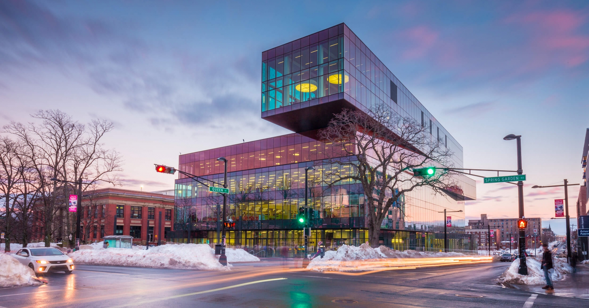
Program for Danish architecture delegation to RAIC Festival of architecture in Toronto
Thursday, October 31, 2019 – Flex Programme
Visit to Canadian architecture firm
Free afternoon to explore Toronto
Group departs on red-eye flight back to Copenhagen
For Details on Festival Programme, see the RAIC Festival Website:
https://festival2019.raic.org
Contact Information
Pamela Tiller
Expert Advisor, Danish Trade Council in North America
pamtil@um.dk
+1 647 233 3676
Schmidt Hammer Lassen – Halifax Central Library

